Slide 1
Maths Workshop
Year 5 and 6
Teachers:
Year 5
Rebecca Steel
Fiona McDonald
Oliver Finegold
Teachers:
Year 6
Mandy Starnes
Laura McPherson
Samantha Beeton

Slide 2
Aims
Share what lessons are like in school
Share the idea of fluency first then building on this with reasoning
Share how we use concrete, pictorial, abstract (CPA) to build understanding
Supporting Children at Home – homework/rocket card
Year 6 SATs
National Curriculum Levels

Slide 3
Welcome to Years 5 and 6
The Maths Curriculum
We follow White Rose – Mastery approach
Ensures confidence in fluency then challenges with reasoning
Concrete Resources
Begin with concrete resources such as diennes and counters
Move towards pictorials representation – may be the same as the concrete or could be other things such as packets of pencils
When secure, move onto abstract methods
People often think older children don’t use resources so much but they do – helps develop a secure understanding of concepts
Maths Vocabulary
A continued focus on Maths language. This should now be more familiar and we will continue to embed it to further support reasoning and problem solving.

Slide 5
Welcome to Years 5 and 6
Facts fluency
Big emphasis on knowing key numbers facts – this supports written calculation and is essential to become confident learners
Key facts they need to know:
Number bonds – all to 20, 100 and links to 1000
Times tables up to 12x12
Homework – year 5
Homework is all based on the rocket cards which have been uploaded to Google Classroom
All based on mental Maths targets previously taught therefore children should have some confidence in them
Written homework and sometimes a suggestion of a website or an activity on Mathletics
This is key to support children in being able to access all areas of Maths.
Homework – year 6
Homework book linked to learning in school
Compulsory – kept in to complete – prepare them for secondary school

Slide 6
Welcome to Years 5 and 6
Mastering Number at KS2
Year 5. Being used in year 6 to build on and embed what they already know.
New program to enhance children’s understanding of multiplication and division.
Daily 10 minutes
Having a positive impact so far

Slide 7
Complete the ratio tables.
6 | 60
11 | __
18 | 180
12 | __
11 | 110
49 | __
21 | 210
48 | __
110
120
490
480
60 | __
14 | 140
16 | __
9 | 90
3 | __
22 | 220
472 | __
30 | 300
600
160
30
4720

Slide 8
Complete the ratio tables.
12 | 1200
53 | __
20 | 2000
48 | __
73 | 7300
91 | __
38 | 3800
90 | __
5300
4800
9100
9000
73 | 7300
9 | __
85 | 8500
31 | __
82 | __
6 | 600
45 | __
10 | 1000
8200
4500
900
3100

Slide 9
Which of these ratio tables has an error?
12 | 120
53 | __
20 | 2000
48 | __
73 | 730
91 | __
38 | 3800
90 | __
530
4800
910
9000
73 | 7300
9 | __
85 | 850
31 | __
82 | __
6 | 600
45 | __
10 | 1000
820
4500
8200
900
310
3100

Slide 10
Describe the additive relationship between 60m and 6m.
Describe a multiplicative relationship between 60m and 6m.
60m
60m – 6m = 54m
6m
6m + 54m = 60m
6m × 10 = 60m
60m is 54m longer than 6m.
6m is 54m shorter than 60m.
60m is 10 times 6m.
6m, 10 times, is 60m.
Mo
Fin
Cal

Slide 11
Describe a multiplicative relationship between 60m and 6m.
60m
6m
÷ 10
6 | 560
60m ÷ 10 = 6m
Length in m
6m × 10 = 60m
× 10
The value of the product in a multiplication equation becomes the value of the dividend in the corresponding division equation.

Slide 12
Describe a multiplicative relationship between 60m and 6m.
60m
60m divided by 10 is 6m.
6m
$\frac{1}{10}$ times 60m is 6m.
$\frac{1}{10}$ of 60m is 6m.
6m is $\frac{1}{10}$ times 60m.
6m is $\frac{1}{10}$ of 60m.
I wonder… who is right?
Cal
Fin
Mo

Slide 13
Write equations to match what each child says.
Mo
Fin
Cal
6m is $\frac{1}{10}$ times 60m.
6m is $\frac{1}{10}$ of 60m.
$\frac{1}{10}$ times 60m is 6m.
$\frac{1}{10}$ of 60m is 6m.
60m divided by 10 is 6m.
6m = $\frac{1}{10}$ × 60m
$\frac{1}{10}$ × 60m = 6m
60m ÷ 10 = 6m
6m = 60m × $\frac{1}{10}$
60m × $\frac{1}{10}$= 6m

Slide 14
Welcome to Years 5 and 6
SATs
In May for year 6
Date | Papers
Monday12th May | SPAG (Spelling, Punctuation and Grammar) paper 1 SPAG (Spelling, Punctuation and Grammar) paper 2
Tuesday 13th May | Reading
Wednesday 14th May | Arithmetic Reasoning paper 1
Thursday 15th May | Reasoning paper 2

Slide 15
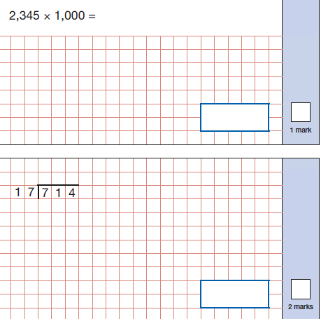
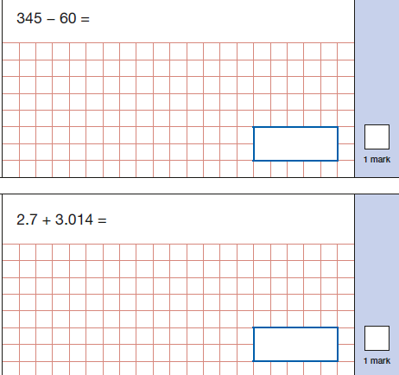
Welcome to Years 5 and 6
SATs
Arithmetic – calculating using mental strategies and written methods – use of all 4 operations, fractions, decimals.

Slide 16
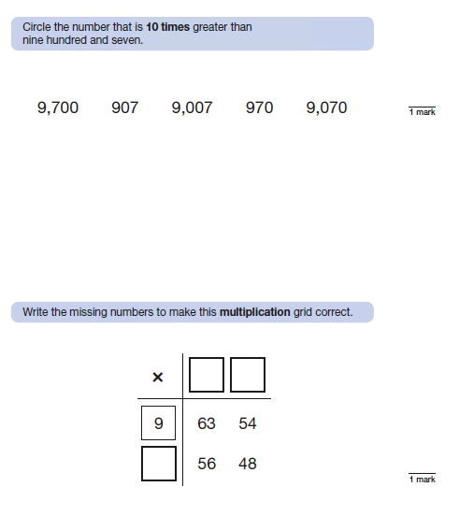
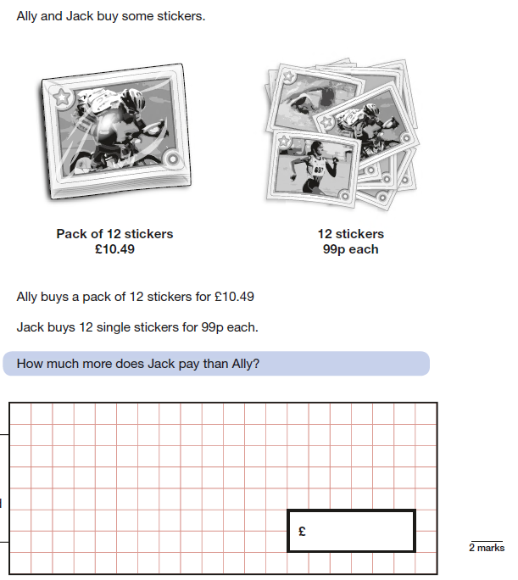
Welcome to Years 5 and 6
SATs
Reasoning – 2 papers. The second one is NOT harder than the first.
Using and applying what they have learnt.

Slide 17
National Curriculum Levels
Children are assessed based on their year group.
Their level begins with the year group number – 5 or 6 then has pairs of letter.
WT – working towards the expected level
ME – Meeting the expected level
EE – Exceeding the expected level
If they are working considerably below their year group’s level, they may be assessed against lower year group’s expectations so they could end the year as 4ME or 3WT for example.
At parents evening we will discuss if they are currently on track for meeting expectations etc but you will only get an assessed level in the end of year report

Slide 18
Questions – where can you find the answers?
School Website
Parents evenings
Online Resources. Please continue to encourage them to use TTRS. Topmarks is also a good website for Maths games. White Rose.
Resources you can take away: rocket card for the appropriate year group, example arithmetic and reasoning papers.

