Slide 1
Tangy Tanghulu
Alice, Simba, Tomai and Riley

Slide 2
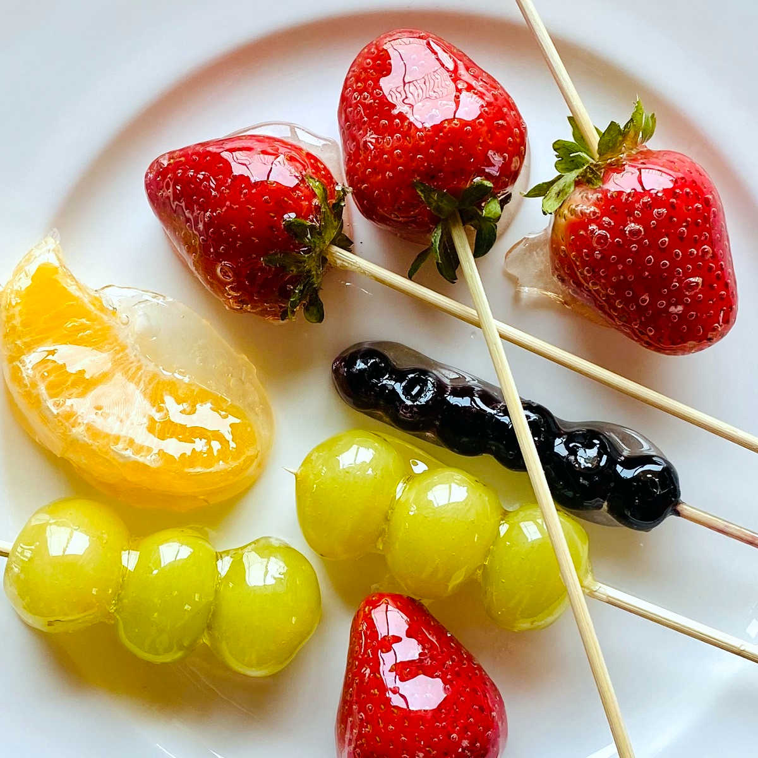
TANGY TANGHULU!
Mango – 85p, Pineapple – 95p, 2 Orange – 30p each, Watermelon - £1.25, Sugar – 75p, bamboo sticks – 25p. In total, it will cost £4.65 with 35p left.
We know it will appeal to parents and children.

Slide 3
Our market research
Our product is sweet and healthy snack and will please over half of our customers.

Slide 4
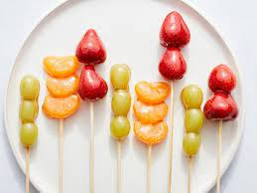
Sales and profits
For our product we will sell it at a price of 80p or 2 for £1.40 and make 40 so we will have from £23.00 to £27.00 profit

