Slide 1
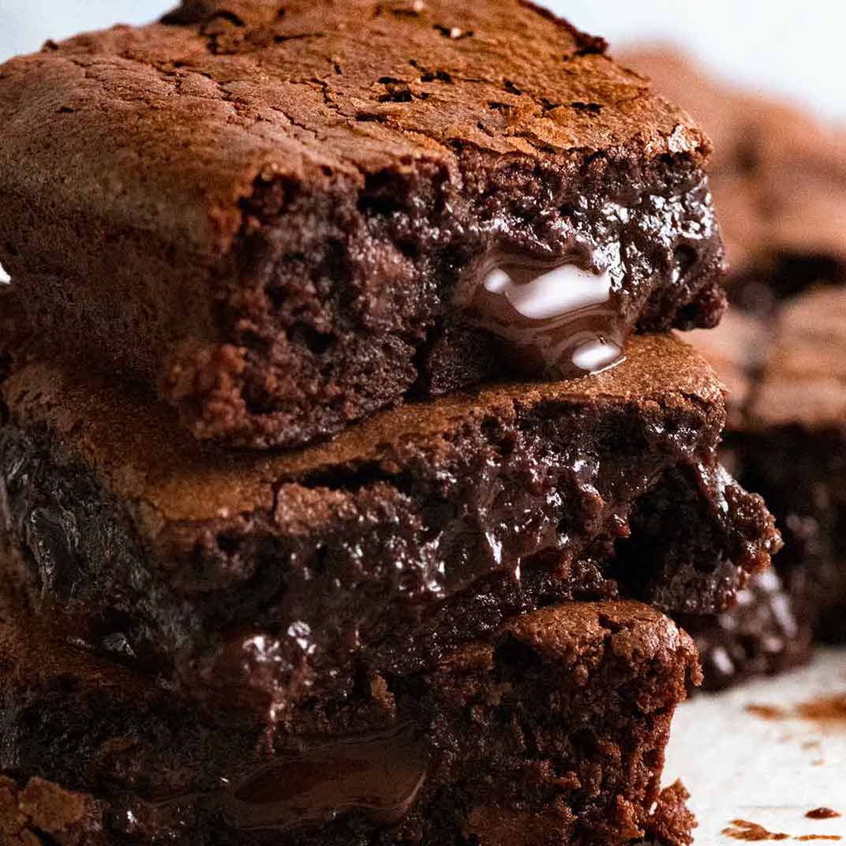
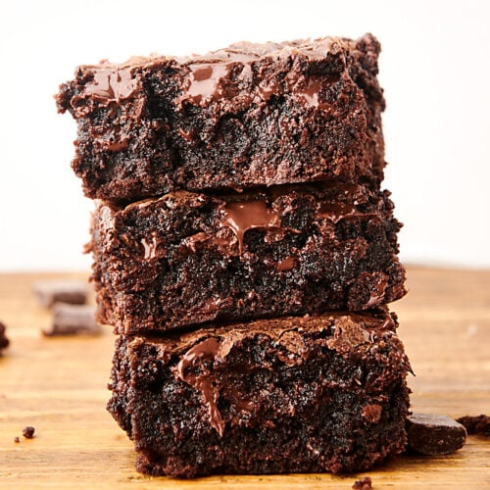
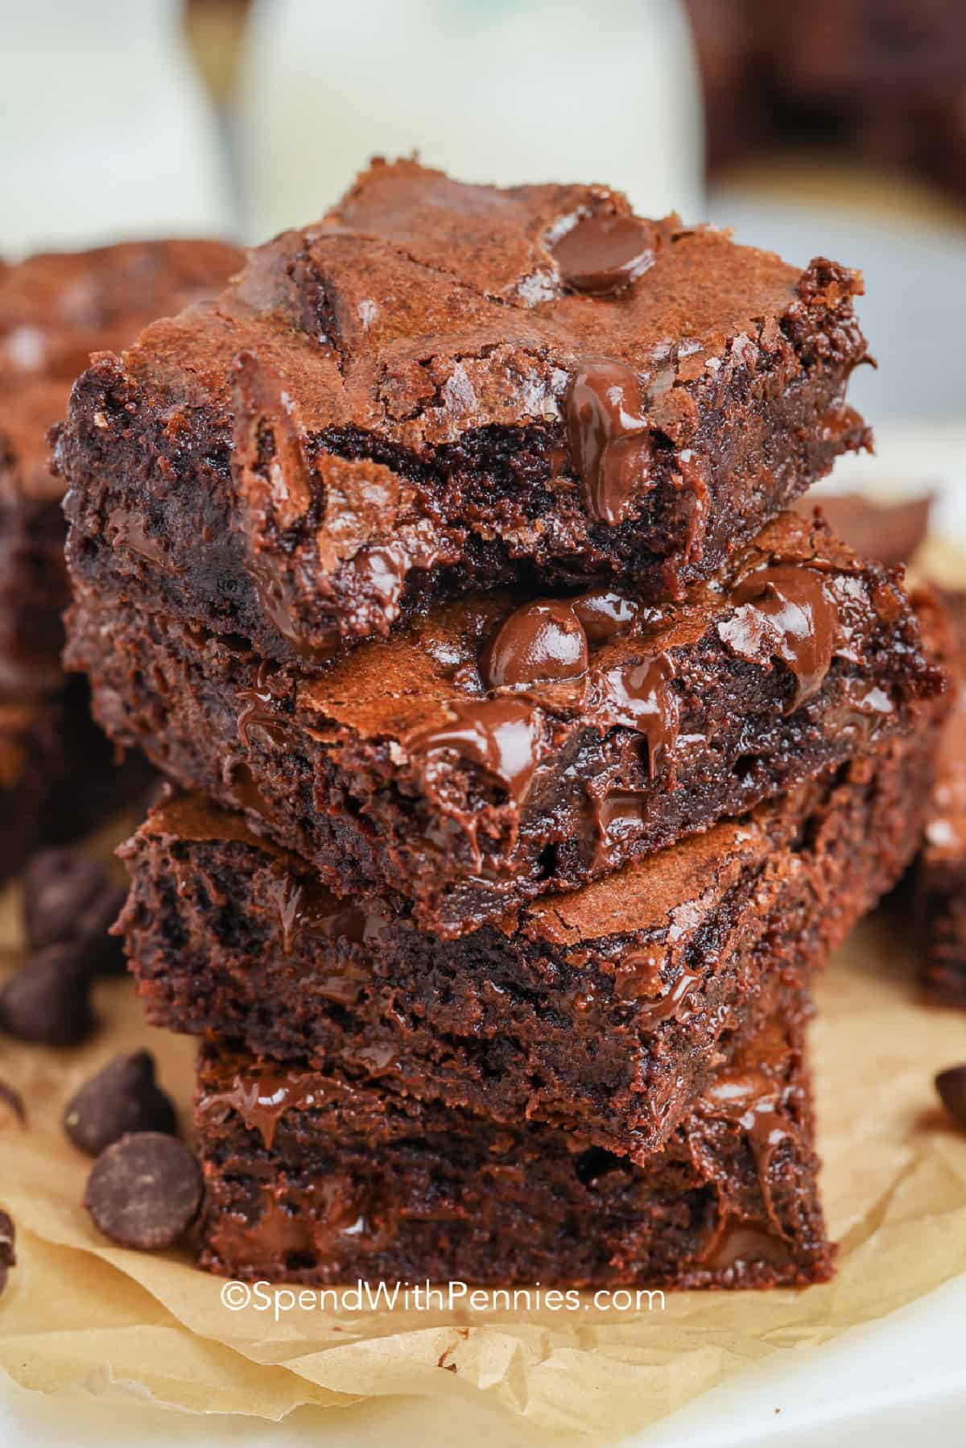
The spectacular, yummy brownie makers
Samantha, La’niya and Bradley

Slide 2
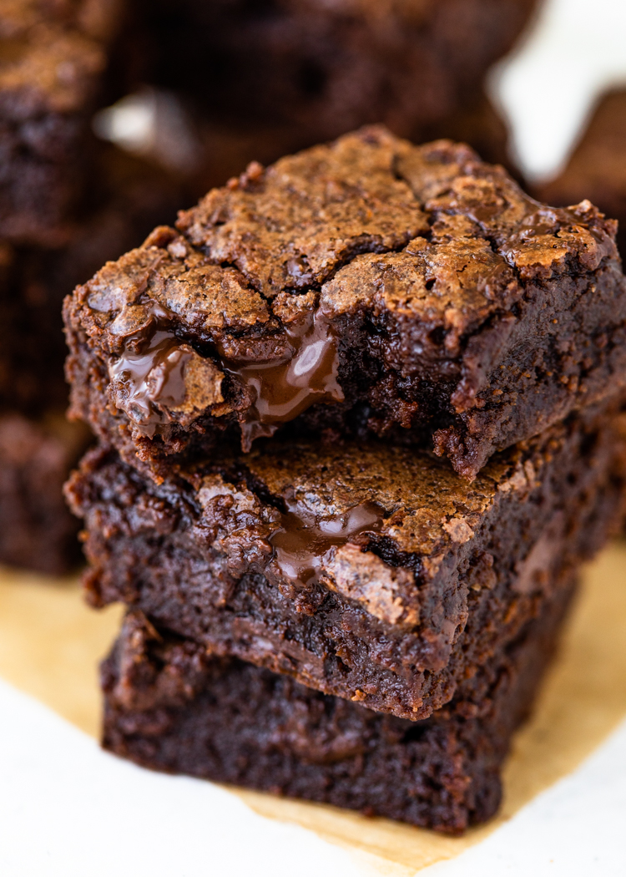
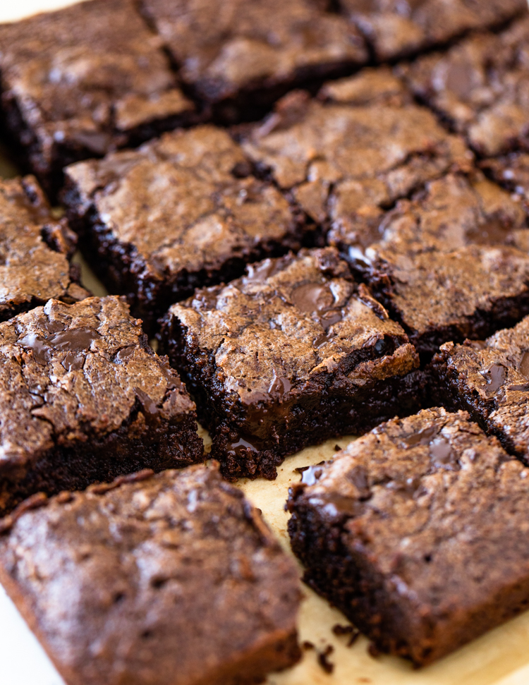
BROWNIE BOOSTS
This chocolate treat is made out of:
A stick of butter
Unsweeted cocoa
Sugar
Eggs
Flour
Salt
We are targeting children from 5yr- 12yrs as most young people (under 13 years) have a sweet tooth and love chocolate and sweets.

Slide 3
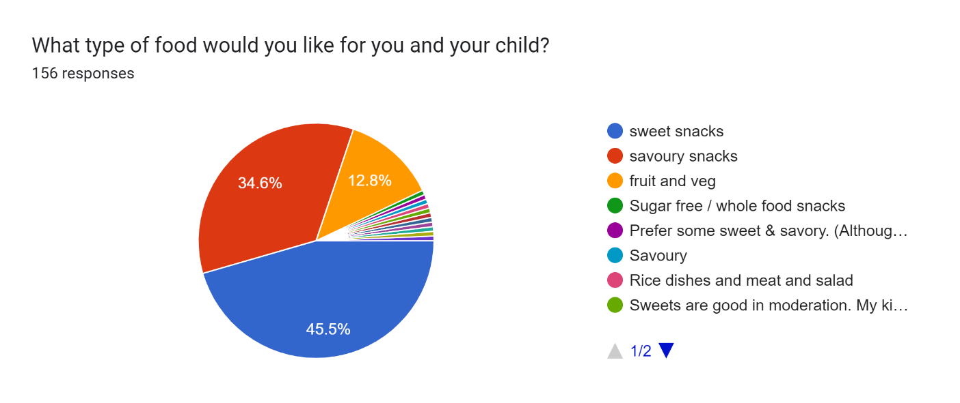
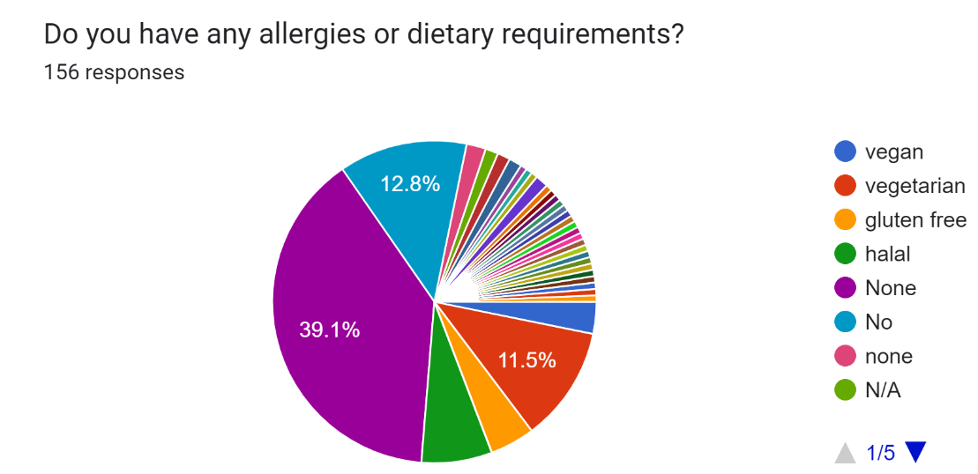
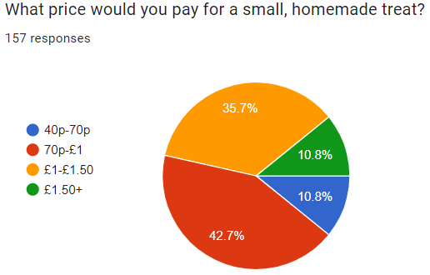
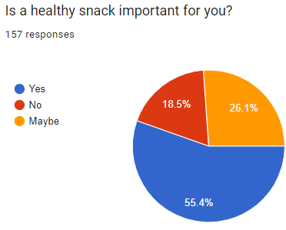
This is our market research
This is our marketing diagrams showing the most and least peoples favourite types of snacks.
I am more than certain that these brownie boost will sell quickly as in the diagrams most people chose sweet snacks, no dietary requirement and 70p-£1.

Slide 4
Sales and profits
Butter is £1.89
Cocoa powder is £1.15
Sugar is 75p
2 large eggs 90p
½ a cup of flour is 45p
I am selling each brownie boost for £1 each as in this graph 70p-£1 was the most popular. We will make a profit of £9 meaning you will get a little less than double your money back.

