Slide 1
Chocolate Cornflake Cakes
By Lily, Hazna, Dayo and Alex

Slide 2
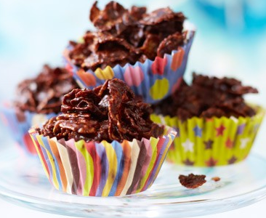
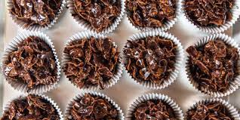
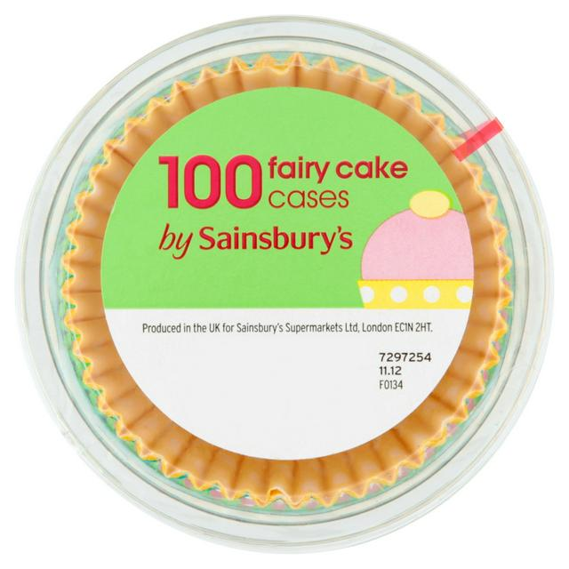
Our cakes:
Ingredients:
We have made sure that our ingredients add up to under £5 (£4.96) and are all from a very local shop- Sainsbury’s. This is what we will need:
Milk Chocolate-45p (x3)
Cornflakes- 69p (x1)
Cupcake cases- £1.75 (x1)
Oreos- £1.20 (x1)
We think our idea will appeal to children because they are cheap and tasty at the same time; they will also look nice.

Slide 3
We think our project will be successful because:
It has chocolate, which is very appealing to children
They look nice
There are at a low cost of 75p
Cornflake cakes are very popular
On our survey sweet snacks were also very popular

Slide 4
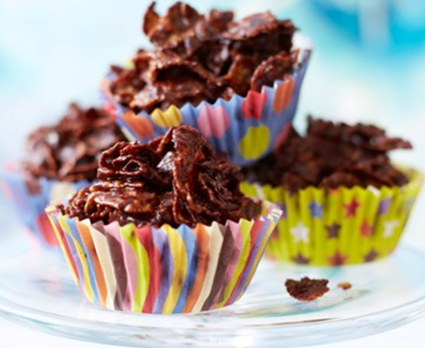
Sales and profits:
Our product will only cost 75p each. All the ingredients will add up to £4.96 (which means we will not be spending all the money). We will end up getting £27 pounds and will be able to pay you back and still have £22. With our mixture we will make 36 cakes- maybe even more- and this will be enough to serve everyone.

Slide 5
Thank You For Watching!!

